Slide 1
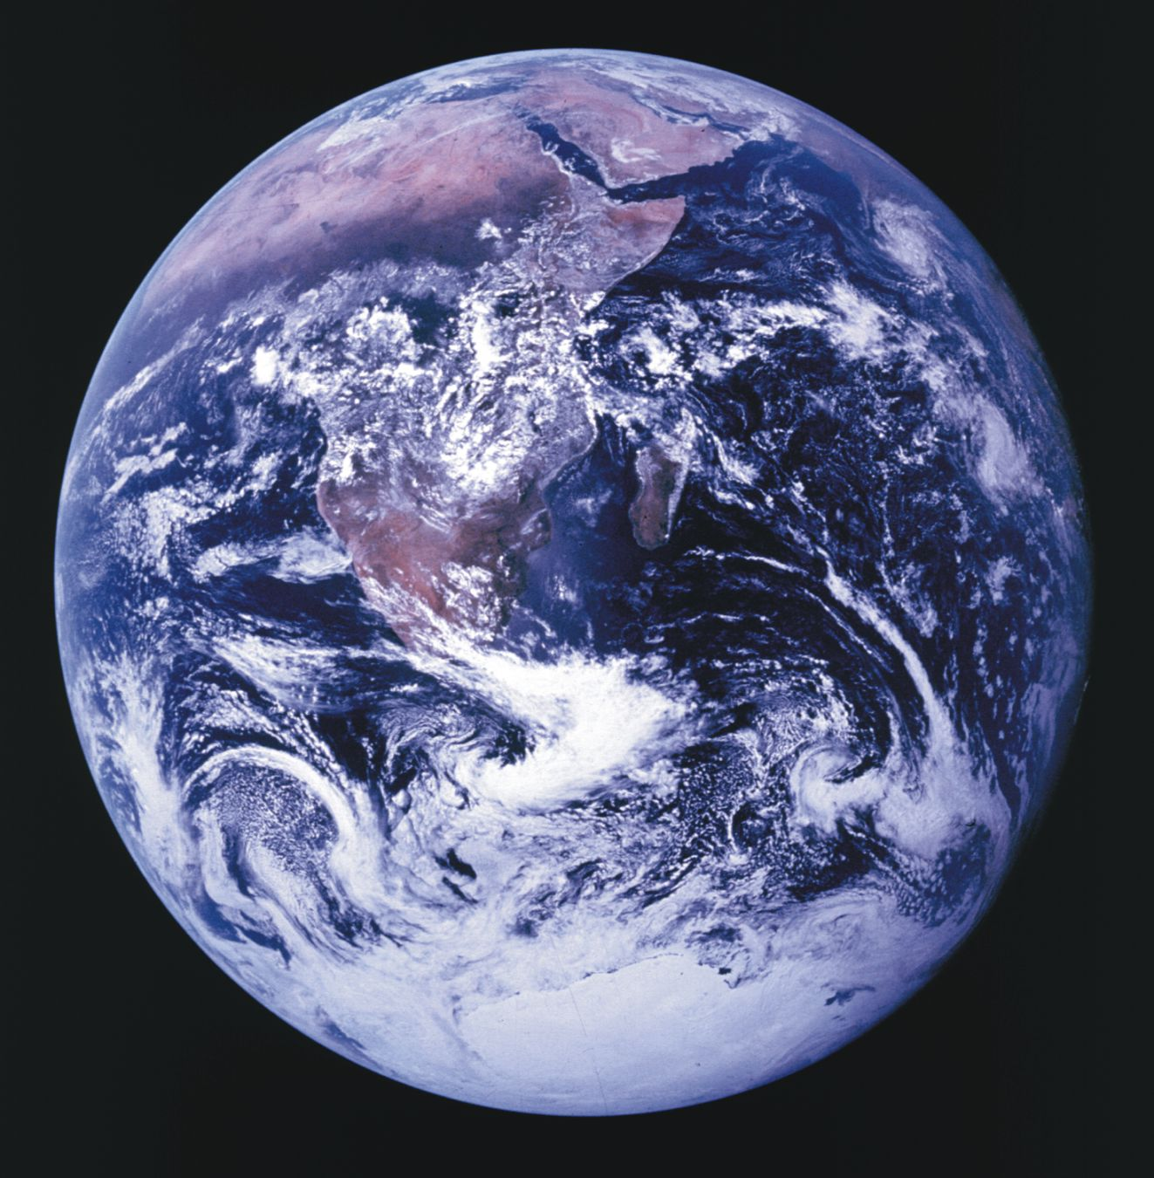




SCIENCE DIPLOMACY
US-Russia Cooperation in the Arctic
Nation
States
~30%
International
Spaces
~70%
National Interests
Common Interests
Prof. Paul Arthur Berkman
Professor of Practice in Science Diplomacy
Fletcher School of Law and Diplomacy, Tufts University
paul.berkman@tufts.edu

Slide 2

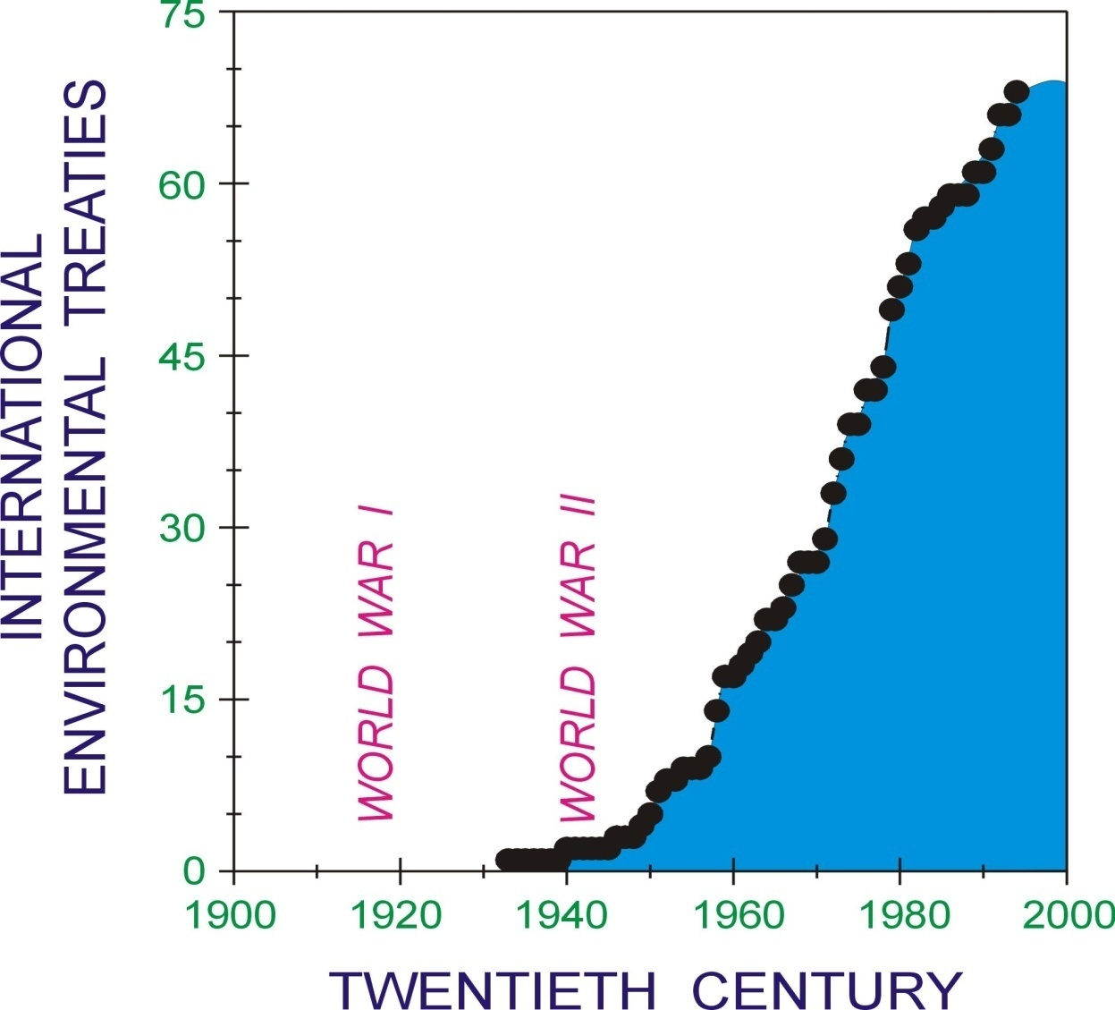
Beyond National Jurisdictions
(impacts, issues and resources)
National interests Common Interests
Deep Sea 1971
Outer Space
1967
Antarctica 1959
High Seas 1958
Berkman 2009. Nature 462: 412-413.

Slide 3
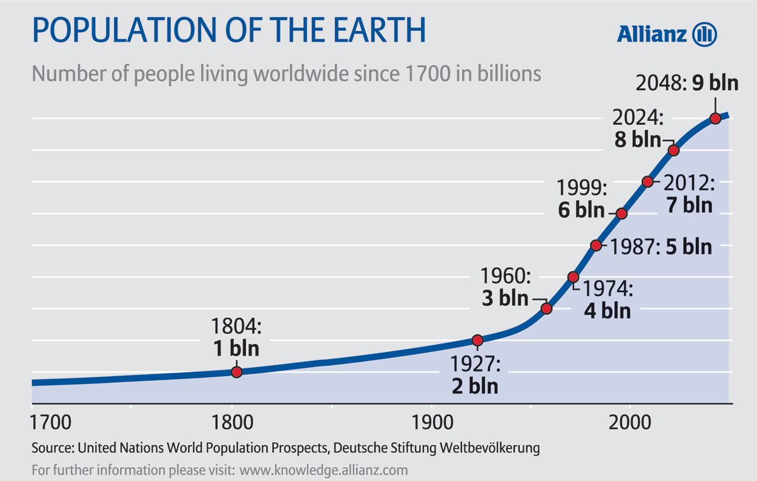
Human Population Growth on Earth

Slide 4

Globally-Interconnected Civilization
Urgencies exists simultaneously across security time scales (mitigating risks of political, economic and cultural instabilities) and sustainability times scales (balancing societal, economic and environmental elements across generations) that must be addressed by nations individually and collectively.

Slide 5
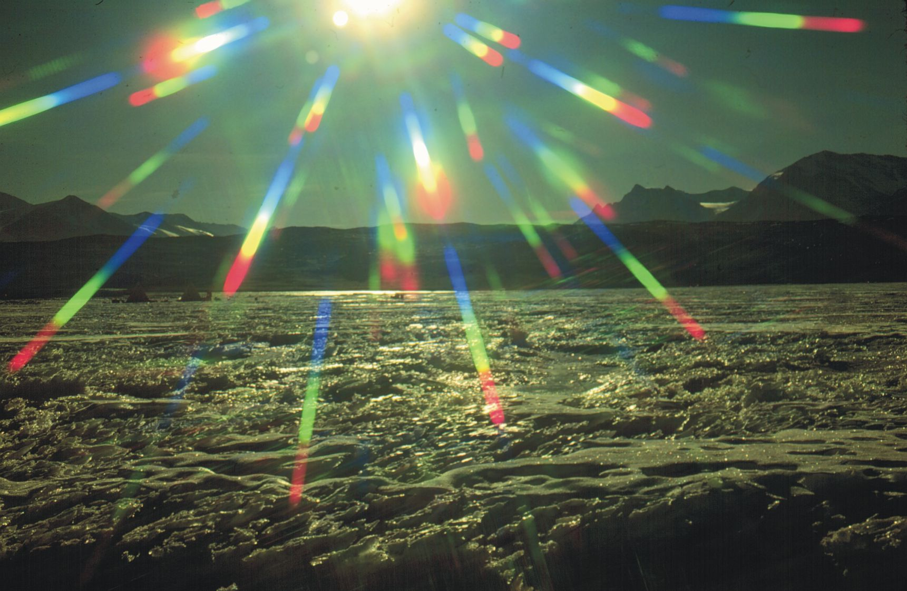
SCIENCE DIPLOMACY is an international, interdisciplinary and inclusive (holistic) process to balance national interests and common interests for the benefit of all on Earth.

Slide 6
Elements of Science Diplomacy
Science (natural and social sciences) as an essential gauge of changes over time and space.
Science as an instrument for Earth system monitoring and assessment.
Science as an early warning system.
Science as a determinant of public policy agendas.
Science as an element of international legal institutions.
Science as a source of invention and commercial enterprise.
Science as an element of continuity in our global society built on a evolving foundation of prior knowledge.
Science as a tool of diplomacy, fostering inclusive dialogues to protect our common welfare and the world we live in.

Slide 7

Soviet President Mikhail Gorbachev
Murmansk, 1 October 1987
Ceremonial Meeting on the Occasion of the Presentation of the
Order Of Lenin and the Gold Star to the City of Murmansk
Therefore, while in Murmansk, and standing on the threshold of the Arctic and the North Atlantic, I would like to invite, first of all, the countries of the region to a discussion on the burning security issues.
peaceful cooperation in developing the resources of the North, the Arctic. Here an exchange of experience and knowledge is extremely important.
scientific exploration of the Arctic is of immense importance for the whole of mankind. … setting up a joint Arctic Research Council.
special importance to the cooperation of the northern countries in environmental protection.
shortest sea route from Europe to the Far East and the Pacific Ocean passes through the Arctic.

Slide 8
Arctic Council
Ottawa Declaration – 1996
The Arctic Council is established as a high level forum to:
provide a means for promoting cooperation, coordination and interaction among the Arctic States, with the involvement of the Arctic indigenous communities and other Arctic inhabitants on common arctic issues*, in particular issues of sustainable development and environmental protection in the Arctic.
* The Arctic Council should not deal with matters related to military security

Slide 9
Science through the Arctic Council
ARCTIC NATIONS
Permanent Participants (indigenous peoples organizations)
Observers (countries and organizations)
ARCTIC COUNCIL
(1996)

Slide 10
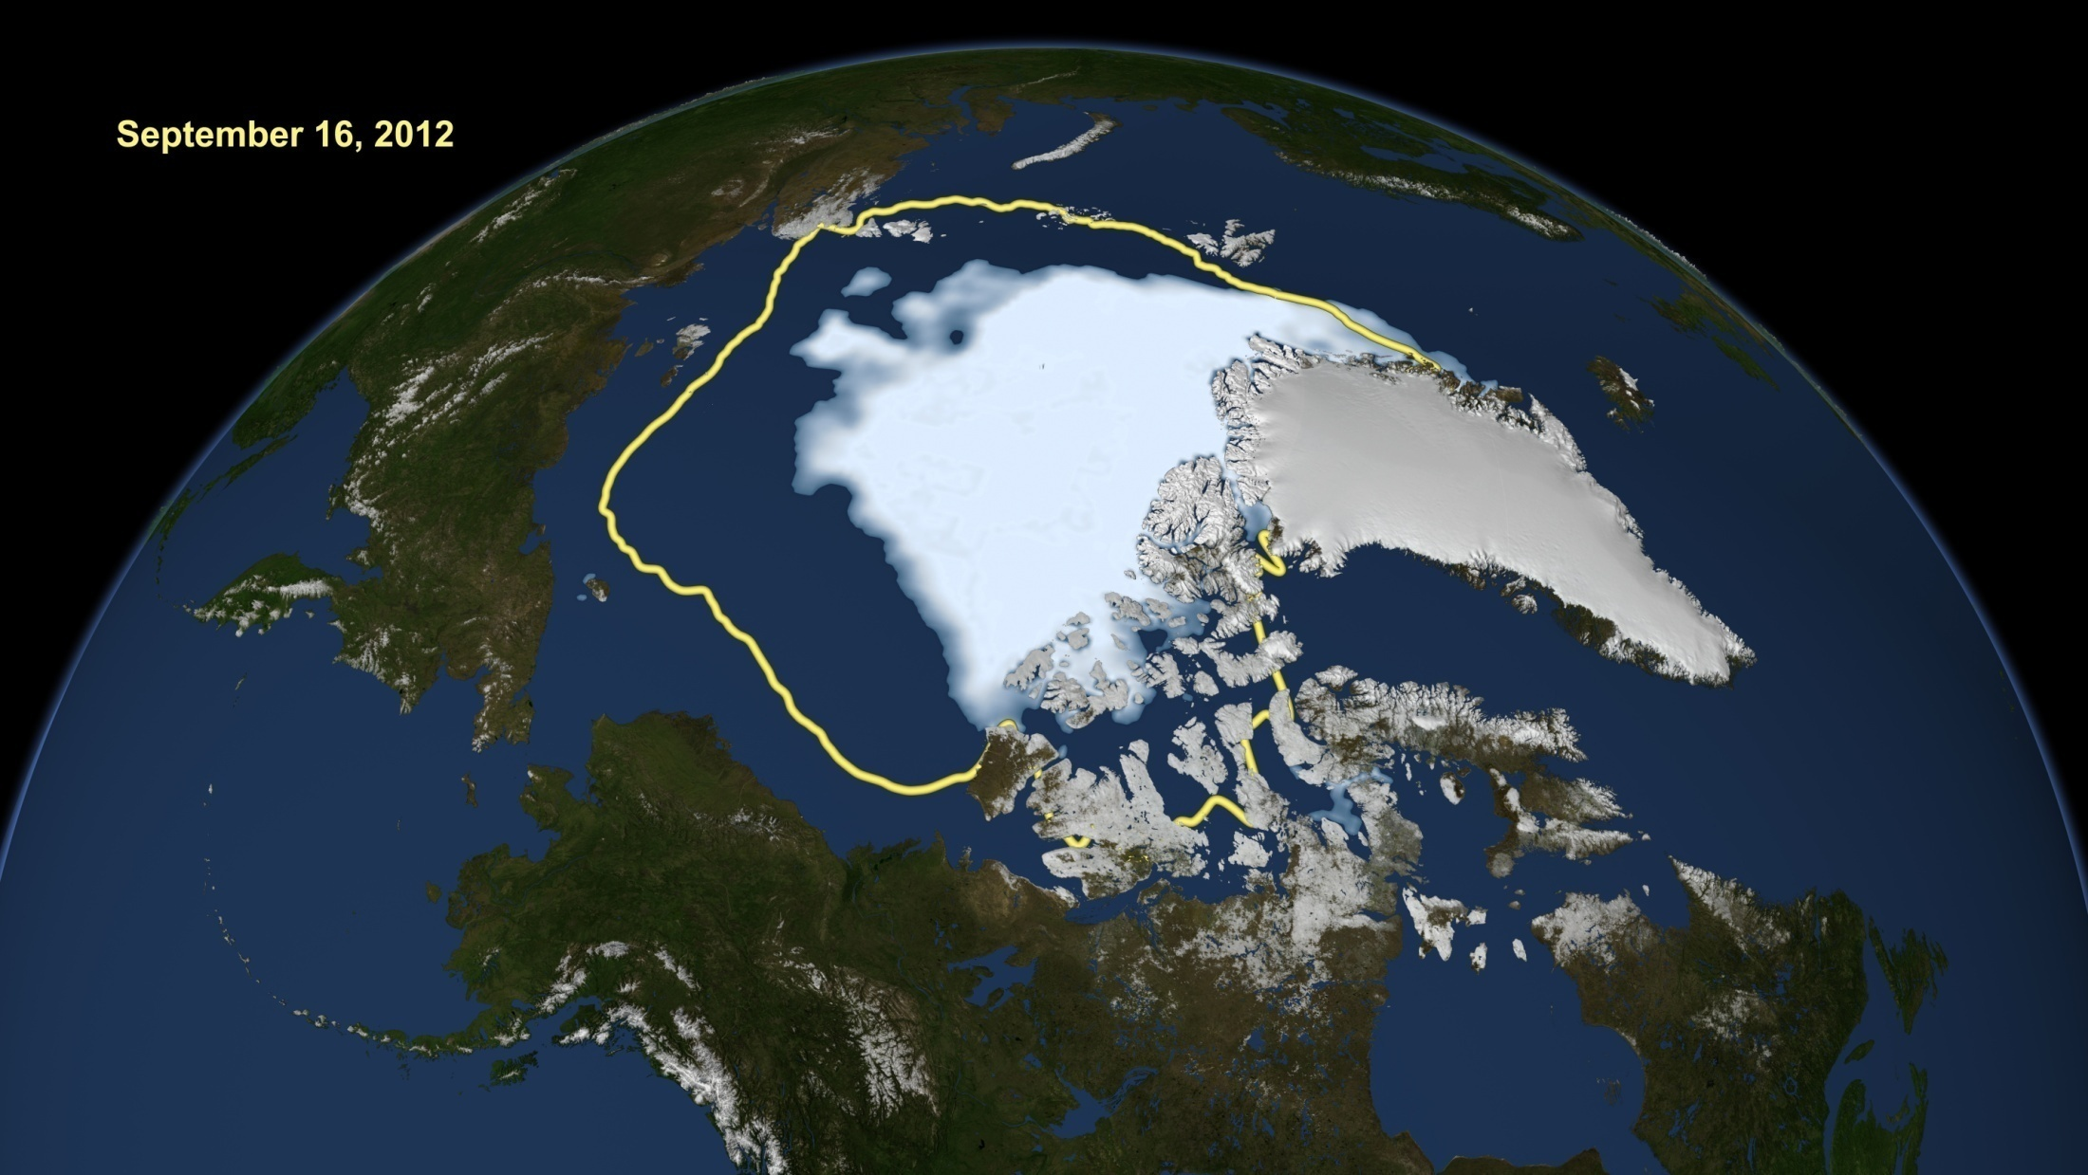
New Arctic Ocean
1979-2010 Average Sea-Ice Minimum
SURFACE BOUNDARY OF THE ARCTIC OCEAN HAS CHANGED
Persistent Sea-Ice Cap for Thousands of Years
Now Seasonally Ice-Free Sea (Summer >50% Open Water)
Risks of Instabilities (Economic, Political, Cultural, Environmental)

Slide 11
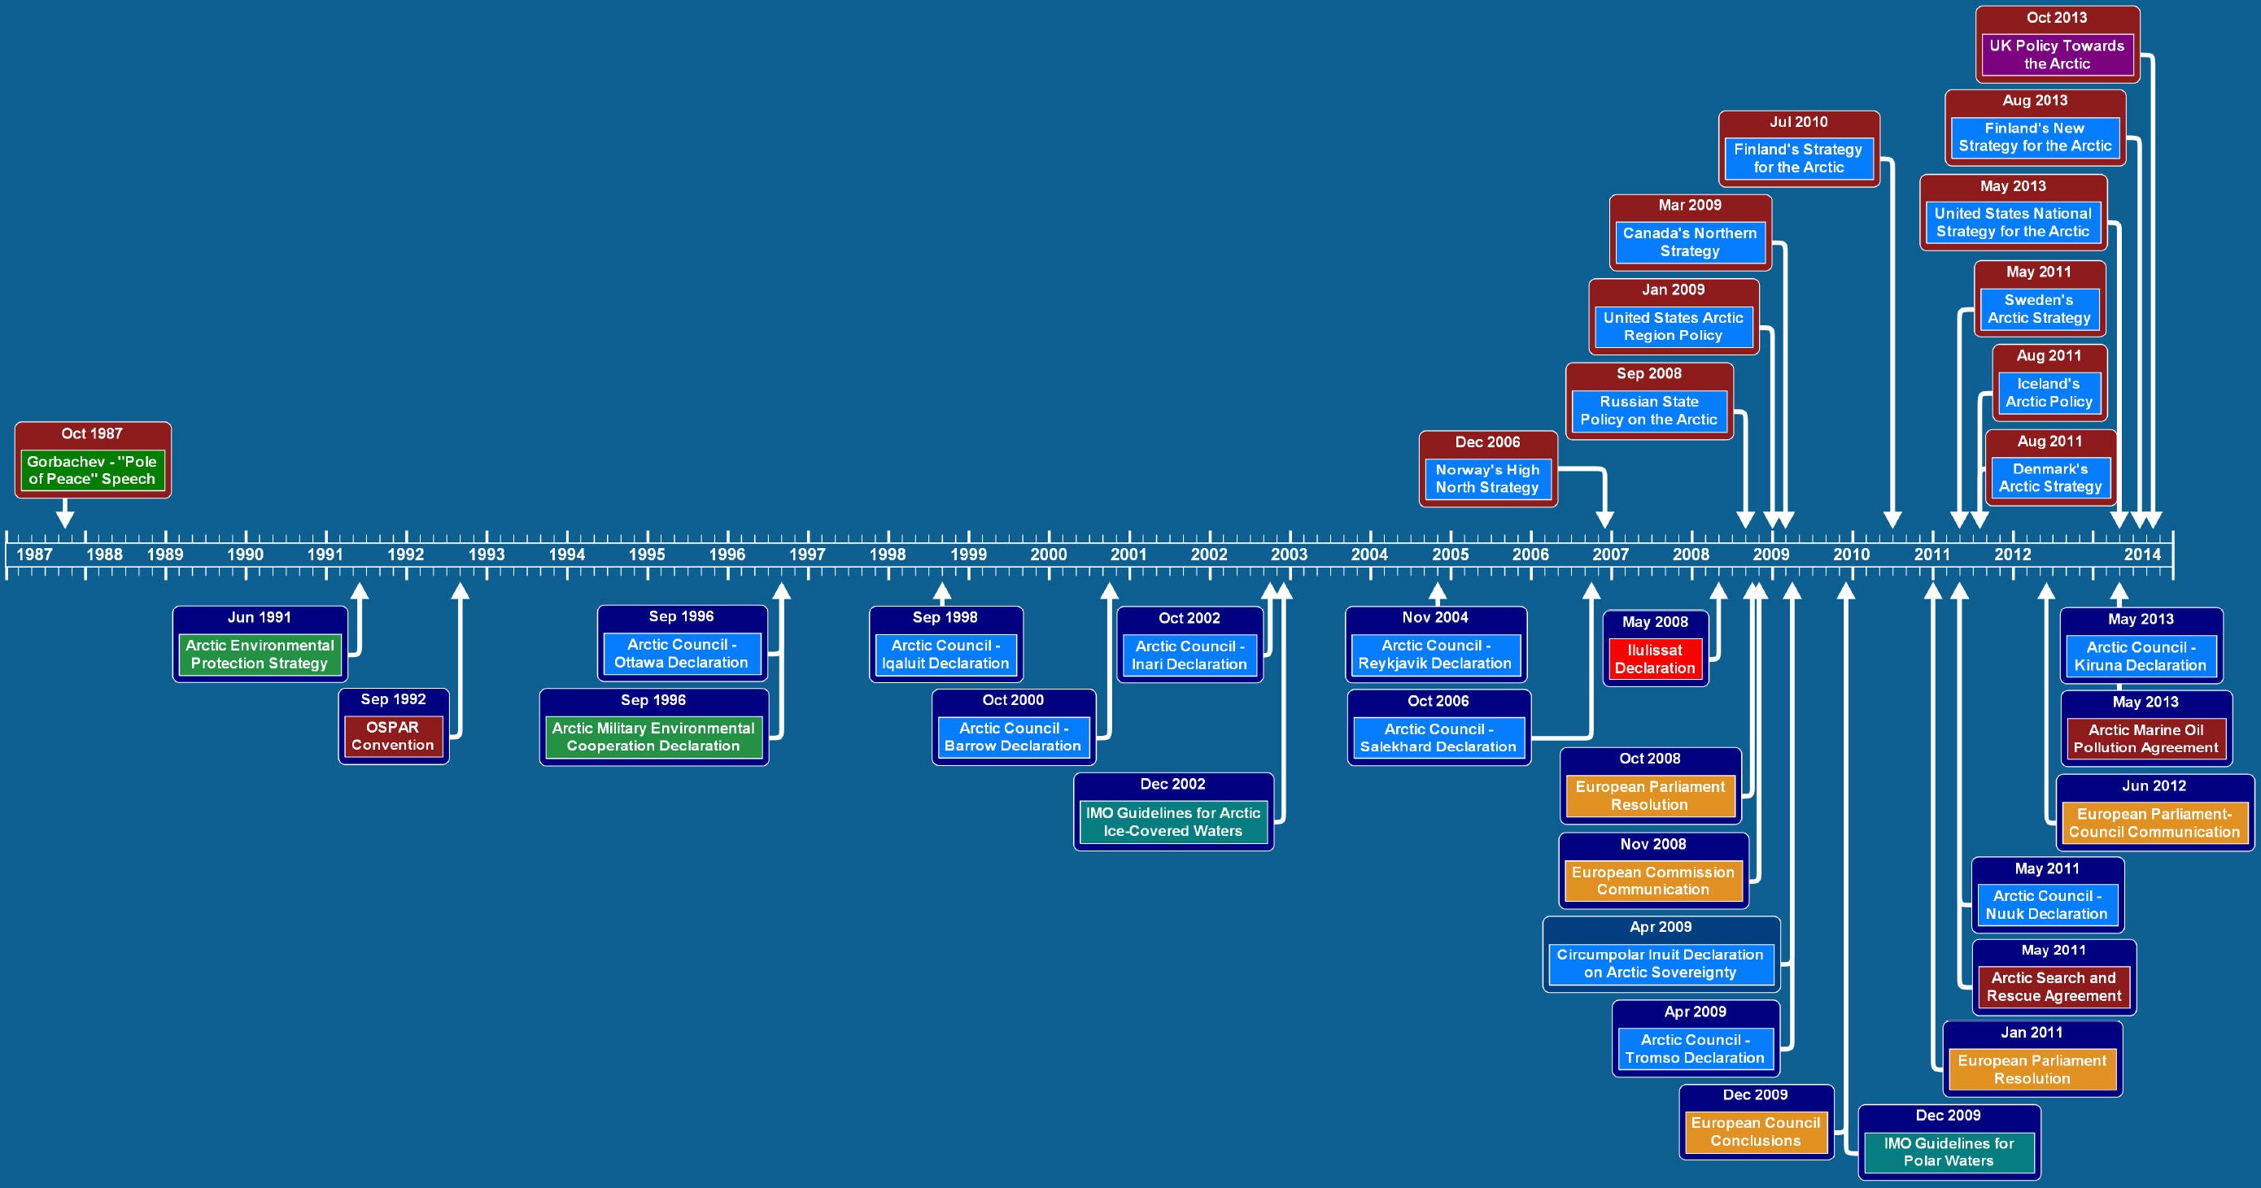
Sustainable Development Phases in the Arctic
2007-2008

Slide 12

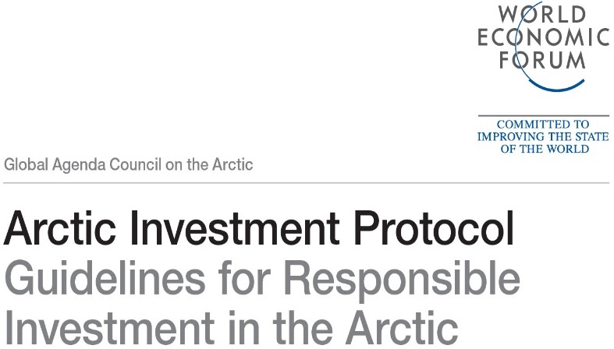
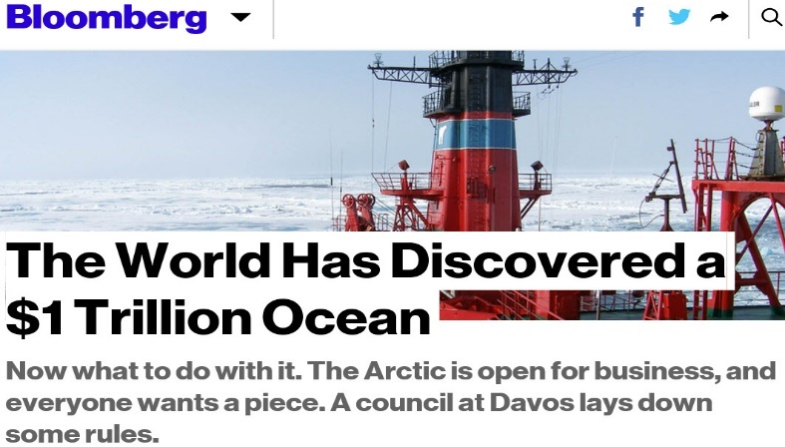
Investment for Arctic Sustainable Development
STABILITY AND BALANCE
Economic Prosperity, Environmental Protection and Societal Well-Being
Urgencies of Today and Needs of Future Generations
Promoting Cooperation and Preventing Conflict

Slide 13
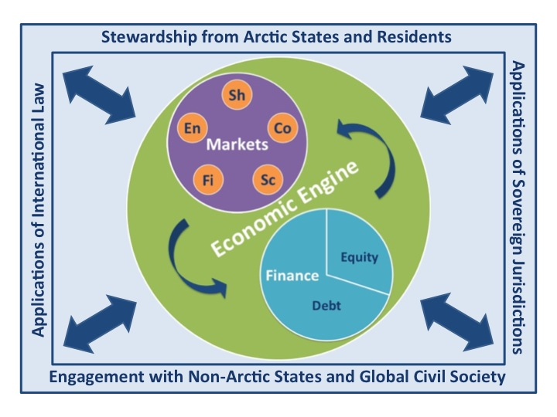
Pan-Arctic Sustainability Across Generations
Balanced multi-lateral insulation from instabilities

Slide 14
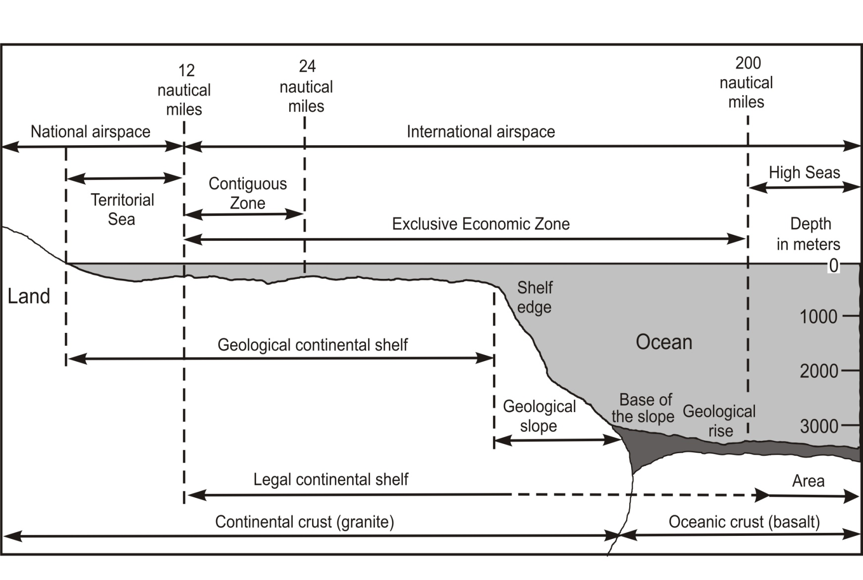
“…important rights and obligations…”
United Nations Convention on the Law of the Sea
Signed: Montego Bay, Jamaica, 10 December 1982
Entered into Force: 16 November 1994
Ratification, Accession or Succession: 155+ Nations
Internal Waters
National Interests Common Interests
Nation State International Space

Slide 15
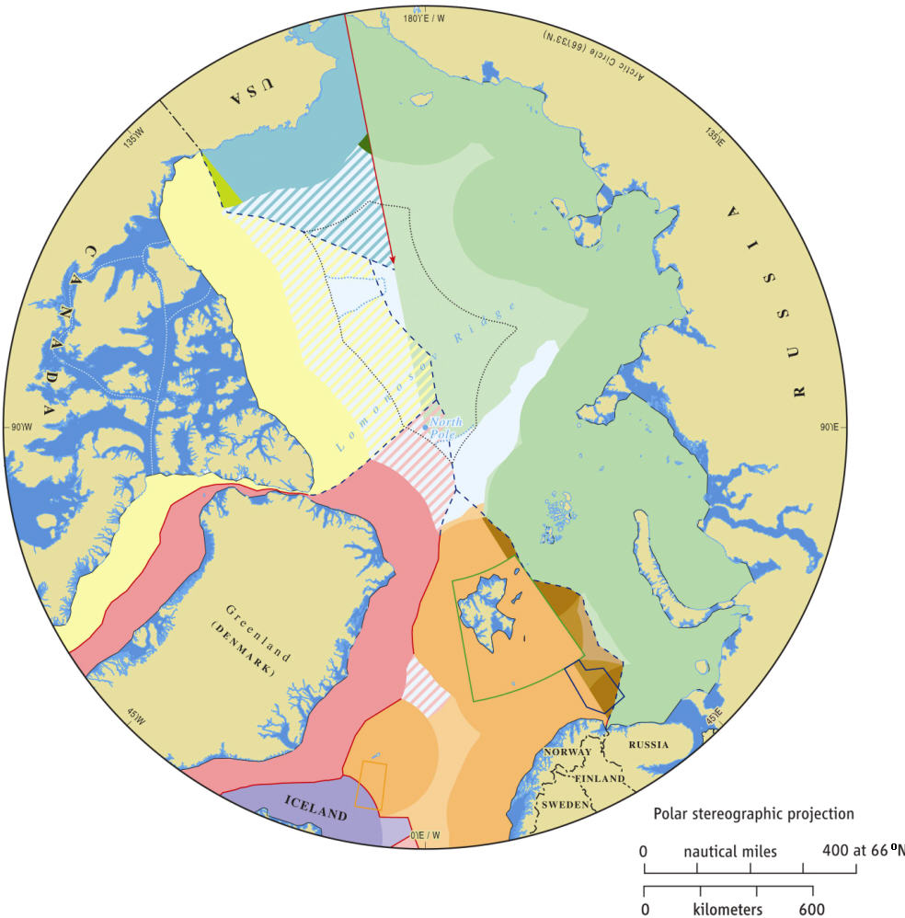
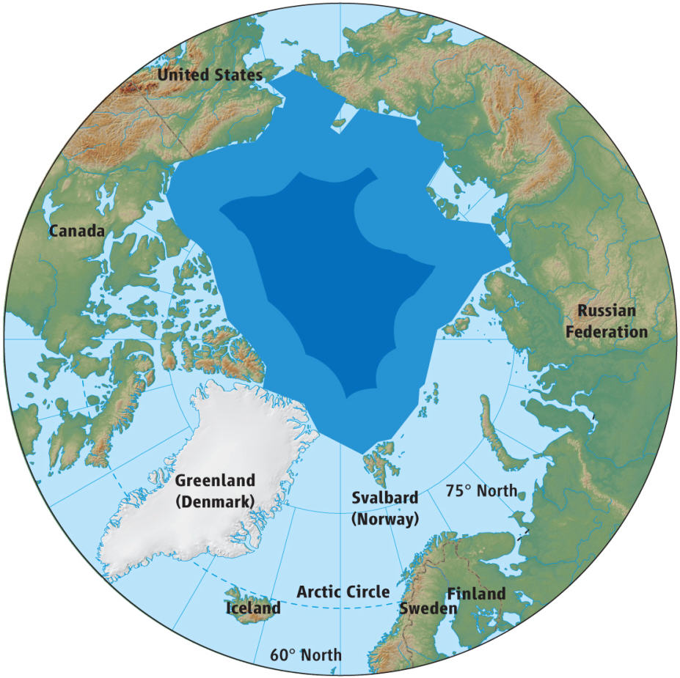
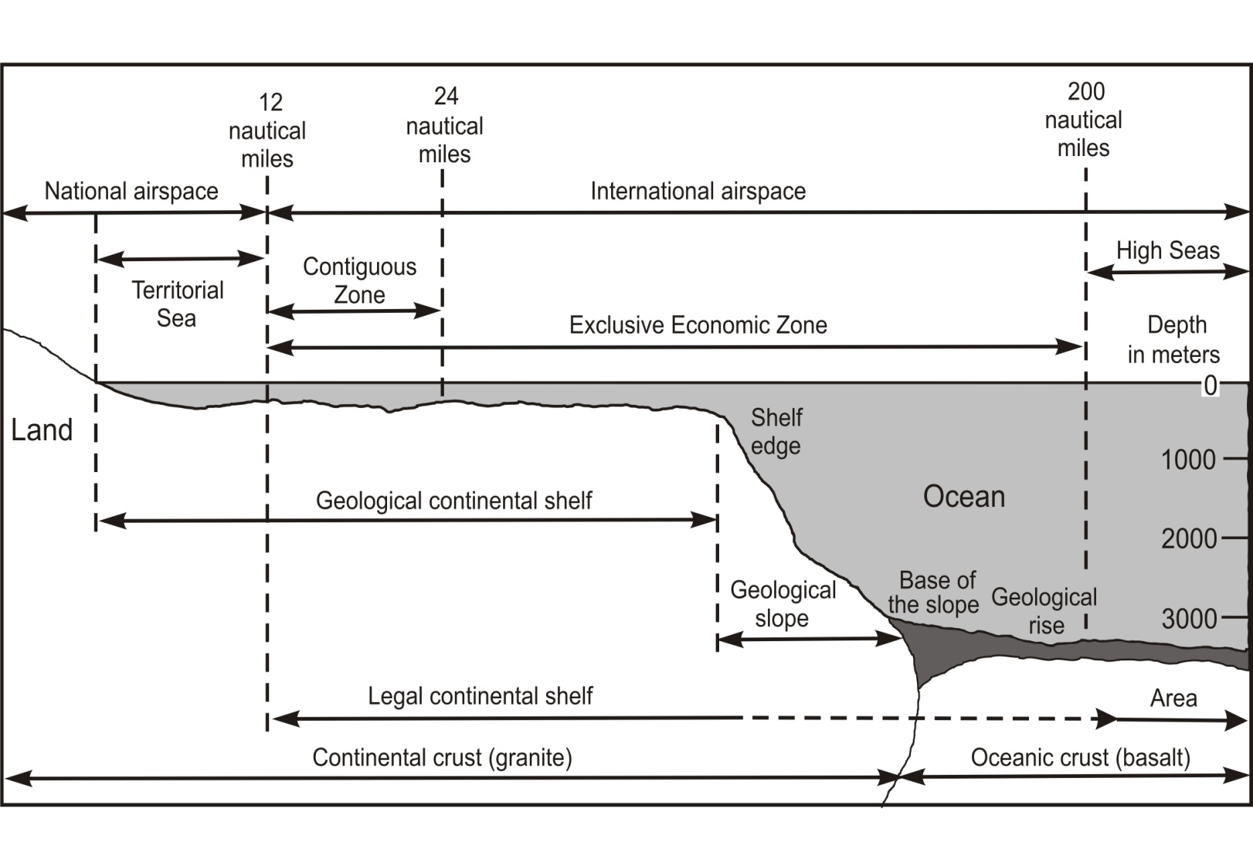
Arctic Ocean in Balance
Environmental Protection, Economic Prosperity, Social Equity, Societal Welfare
Urgencies of the Present and Needs of the Future
Promoting Cooperation and Preventing Conflict
United Nations Convention on the Law of the Sea
Signed: Montego Bay, Jamaica, 10 December 1982
Entered into Force: 16 November 1994
Ratification, Accession or Succession: 155+ Nations
Center of Gravity
Sea Floor
National Interests
Water Column
Common Interests
Berkman and Young 2009. Science 324:339-340.
Nation State International Space

Slide 16
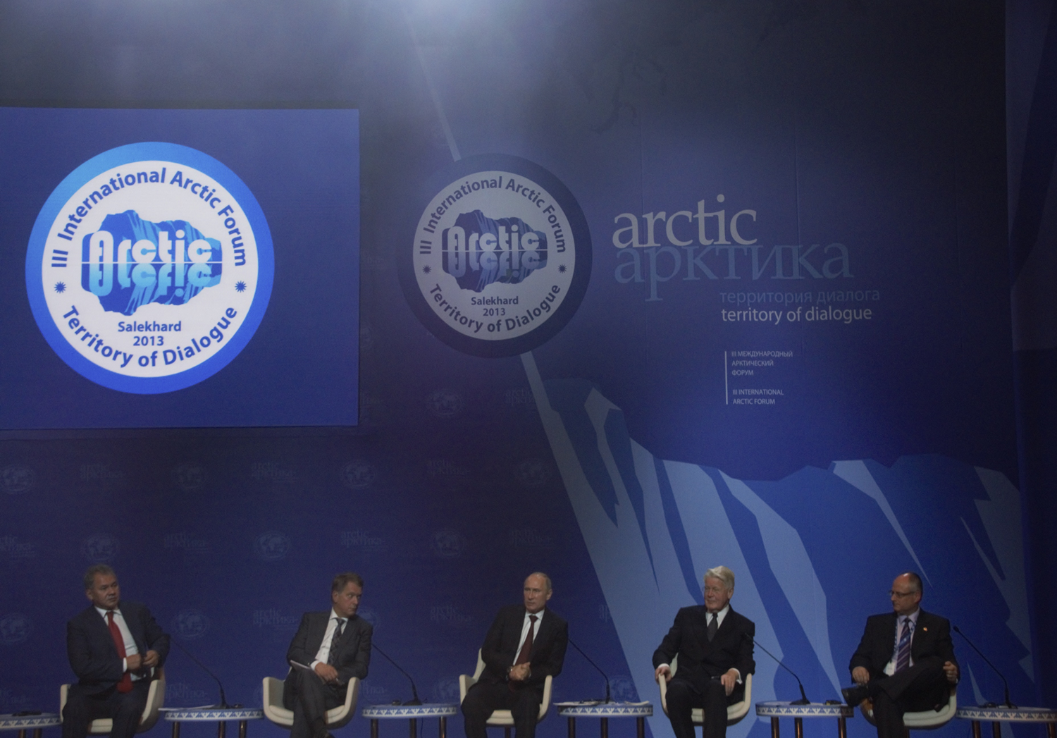
Arctic as a Territory of Dialogue

